Slide 1
MANAGING FRESHWATER FISH POPULATIONS
#8986-E

Slide 2
Introduction
Fish ownership is the property of the individual or state that owns the rights to the water.
The state government is responsible for managing fish and fishing in public waters.

Slide 3
Landowners may manage ponds, reservoirs, impoundments, or even lakes, if they are completely on privately owned land.
Though wild game is the property of the people of the state, fish ownership is the property of the entity that owns the waters.

Slide 4
These privately owned waters can contain a diverse population or only one species.
In aquaculture, a single species is the standard.

Slide 5
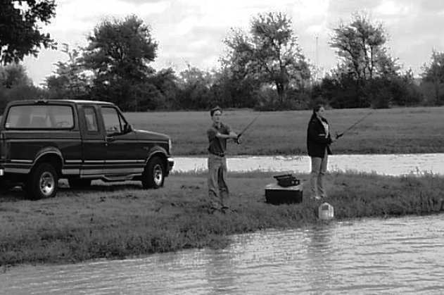
In pond production, some landowners may choose to stock a single species.
Most will opt for a diverse population.

Slide 6
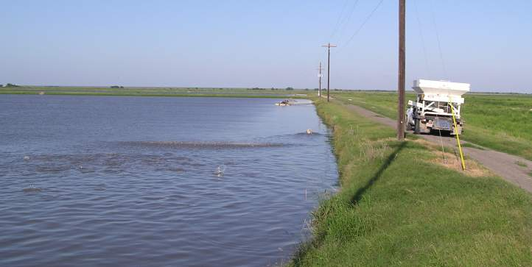
Aquaculture is very intensive and requires daily attention.
Recreational ponds are less intense and do not require daily attention.
Photo by M. Jasek.
Aquaculture Video

Slide 7
Selecting Fish Species
Several fish species are popular in recreational ponds.
Although channel catfish and hybrid largemouth bass are the main game species, hybrid striped bass, red drum, blue catfish, and flathead catfish are also used for stocking.

Slide 8
In northern states, certain trout and salmon species are stocked.
Crappie, sunfish, crayfish, and minnows are stocked as fish fodder, but also provide food for humans.

Slide 9
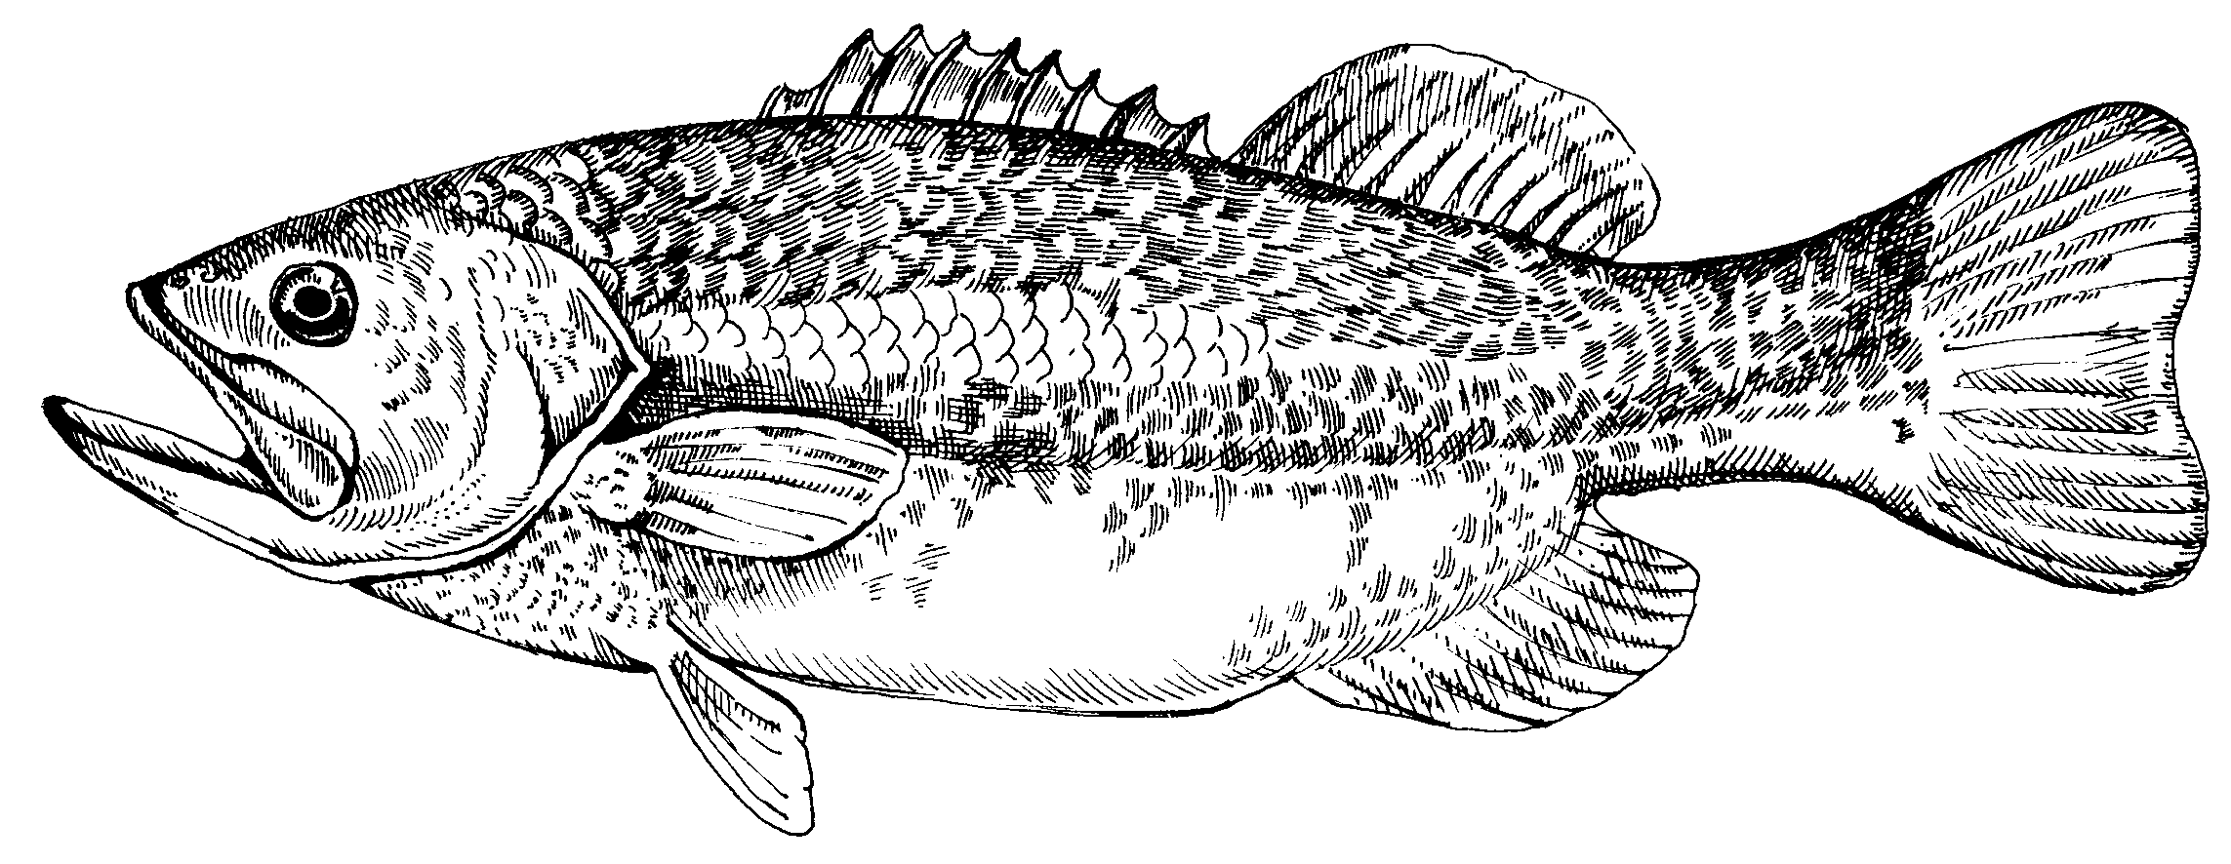
The largemouth bass is the largest in the sunfish family.
Illustration by Christine Stetter.

Slide 10
The native largemouth still exists, but the Florida hybrid bass is the species commonly stocked.
Its hybrid vigor is responsible for weights in excess of 20 pounds
A pond should be ¼ acre or larger for this species.

Slide 11
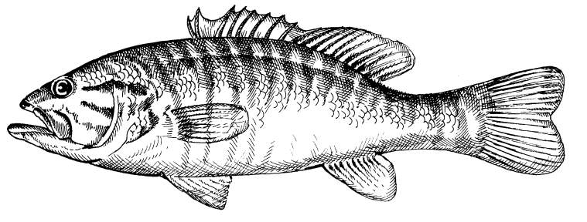
The smallmouth bass is similar to the largemouth bass in shape and color, but rarely exceeds five pounds.
As the name suggests, the mouth is smaller than the largemouth species.
Illustration by Christine Stetter.

Slide 12
Ponds should be ½ acre or larger for smallmouth bass.
They also prefer ponds with a gravel base and a depth of 10 feet.

Slide 13
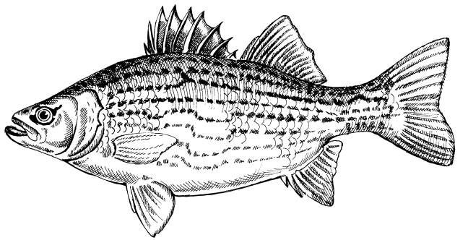
Hybrid striped bass are a cross between the white bass and the striped bass.
It is a popular game fish and a good food fish.
Illustration by Christine Stetter.

Slide 14
Hybrid striped bass will feed on a variety of prey fish species, but will also accept a commercial feed.
They can tolerate water temperatures from 25°F to 90°F.

Slide 15
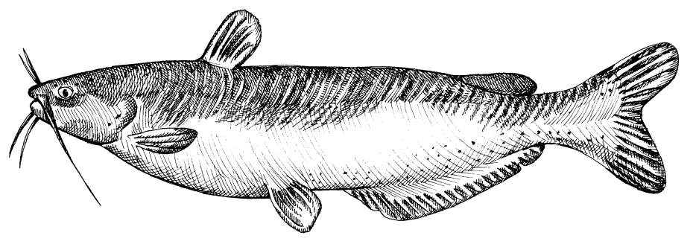
The channel catfish is the most popular stocked fish of the catfish family.
Illustration by Christine Stetter.

Slide 16
Channel catfish adapt well to pond stocking and management throughout the South.
They winter well, but grow best when water temperatures are from 80°F to 85°F.
Properly stocked ponds require little maintenance.

Slide 17
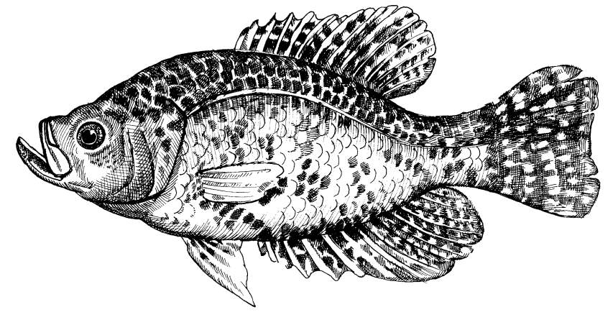
Black crappie is a popular pan fish and does well when stocked with bass.
Illustration by Christine Stetter.

Slide 18
Black crappie provide food to predator fish and will feed on small fish and insects.

Slide 19
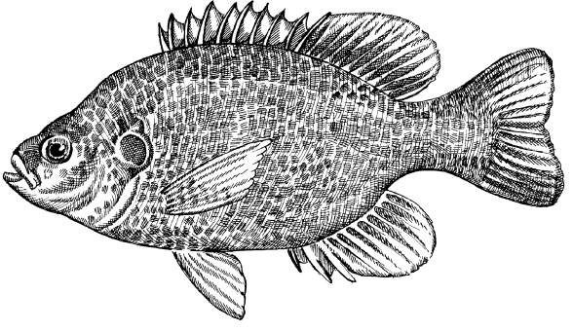
Red-ear sunfish are a popular sport fish that prefer deeper waters.
They can grow to 12-inch lengths and weigh several pounds.
Illustration by Christine Stetter.

Slide 20
The primary purpose for red-ear sunfish is fodder for bass species.
They do not overpopulate a pond as easily as bluegills.

Slide 21
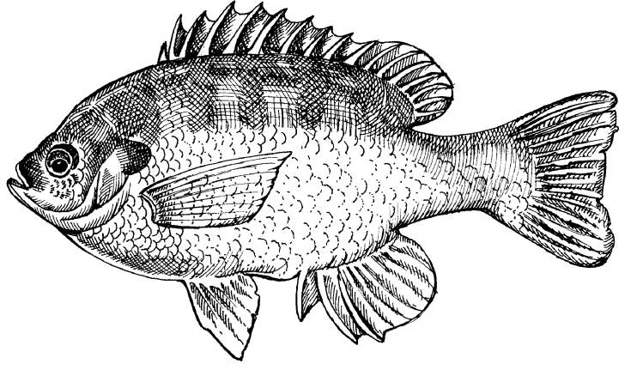
Bluegill sunfish (bream) are another good food source for largemouth bass and other game fish species.
Illustration by Christine Stetter.

Slide 22
Bluegills tend to overpopulate a pond.
They feed on insects, insect larvae, and occasionally, small fish, but will also eat commercial feeds.

Slide 23
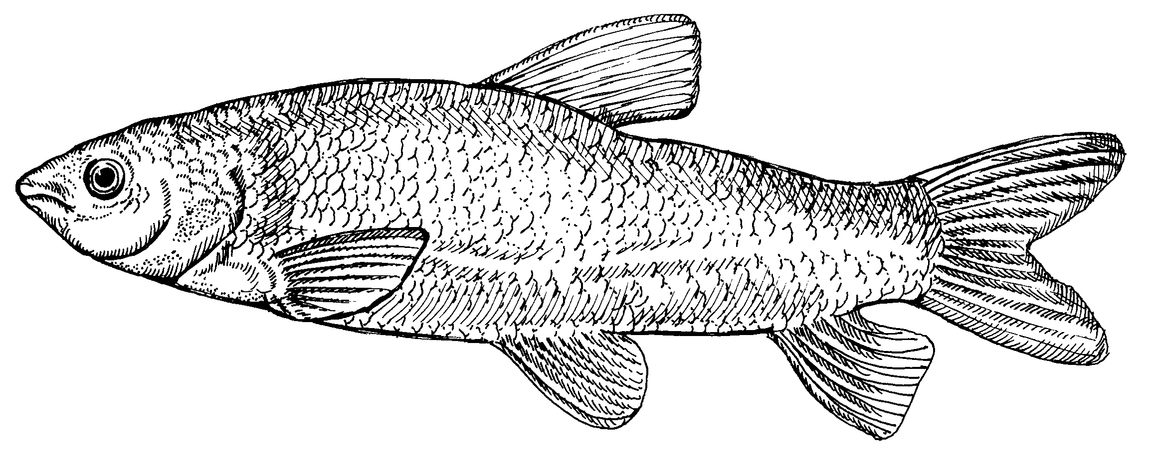
The triploid grass carp is a genetic development of the diploid grass carp.
Illustration by Christine Stetter.
Asian Carp Video

Slide 24
The grass carp (white amur) is fertile and will reproduce.
The triploid strain has an extra chromosome that makes it infertile.
Stocking the diploid grass carp is illegal in 35 states, including Texas.

Slide 25
The grass carp feeds on aquatic vegetation.
They do not take a bait and cannot be fished.
Diploid grass carp will reproduce and outgrow its food supply.
This will strip a water habitat of cover needed by game and prey species.

Slide 26
Triploid grass carp also feed on aquatic plants, but they will not reproduce and outgrow the food supply.
As of January 23, 1992, it became legal to stock triploid grass carp.
A permit is still required and a fee must be paid; plus, there is an additional stocking fee per fish.

Slide 27
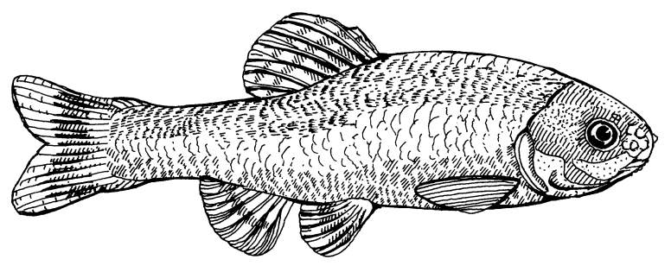
The fathead minnow is a popular baitfish and is stocked as fodder for predator fish.
Illustration by Christine Stetter.

Slide 28
Stocking of minnows should proceed stocking of game fish to allow time for minnows to reproduce and develop a stable population.
Fathead minnows feed on algae, detritus, and zooplankton.
PVC pipe and empty beverage cans are nesting areas for the fathead minnows.

Slide 29
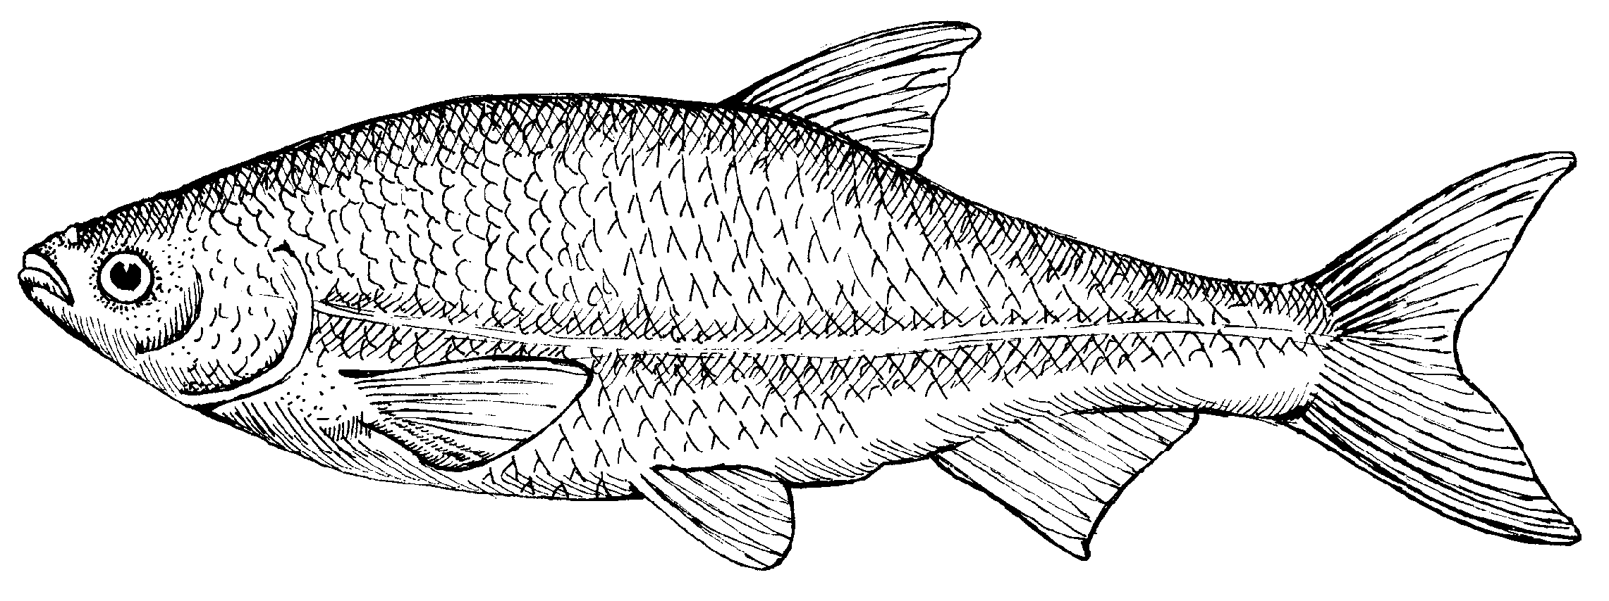
The golden shiner is an excellent baitfish and fodder.
Commercial production meets both needs.
Illustration by Christine Stetter.

Slide 30
Adult golden shiners can grow 8 to 10 inches.
They feed on zooplankton, insects, filamentous algae, and small fish.

Slide 31
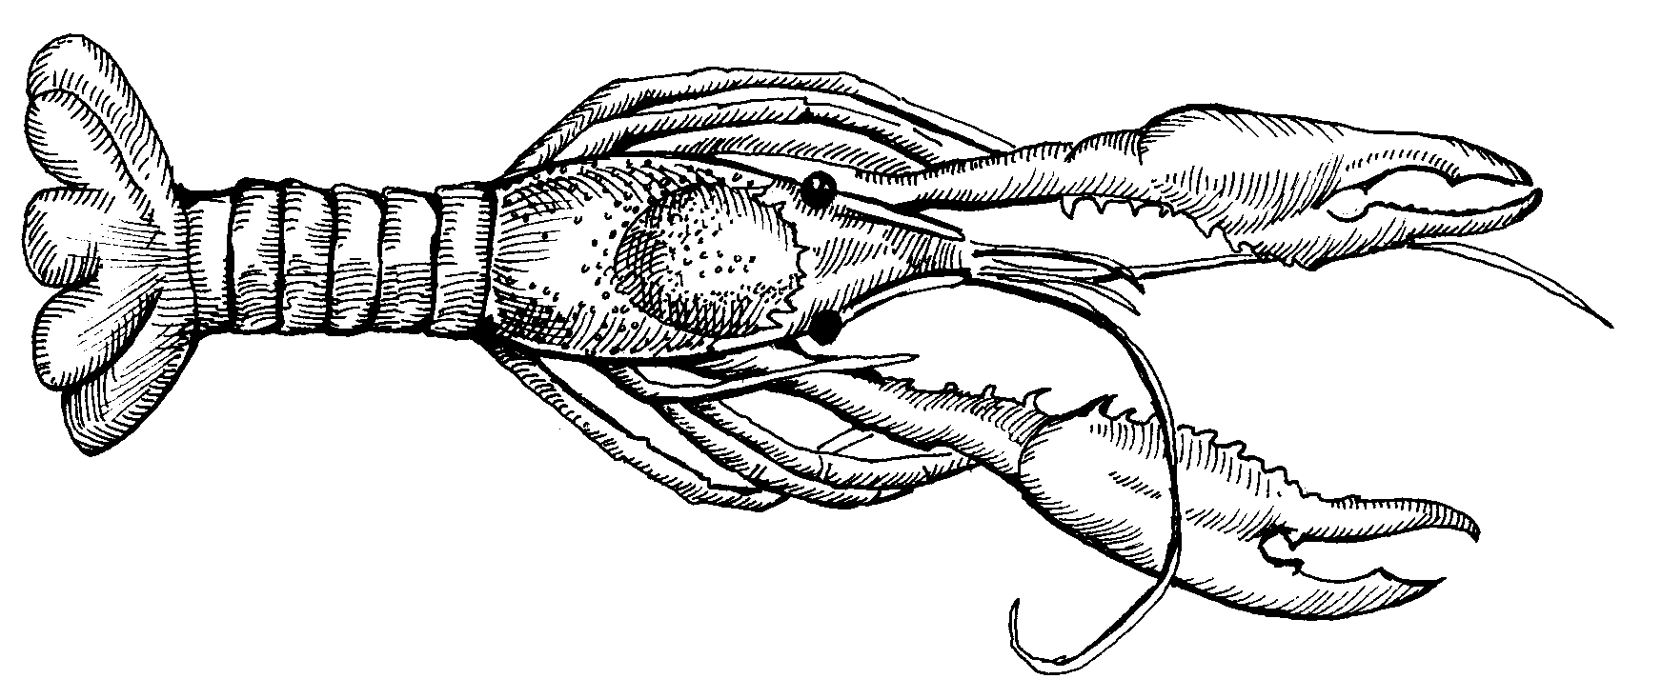
Crayfish exist worldwide.
Of the 500 species, half are found in North America.
Both fish and humans will consume crayfish.
Illustration by Christine Stetter.

Slide 32
Crayfish feed on plant and animal matter including algae, insect larvae, worms, tadpoles, and tiny fish.
During the molting process, they become more vulnerable to predators.

Slide 33
Stocking Rates
The objectives of the landowner dictate stocking rates.
Personal preference, projected harvest, and natural production ability of the pond are factors in determining stocking rates.

Slide 34
Fertilizing a pond will allow the manager to increase stocking rates.
Stocking should include both predator and prey species.

Slide 35
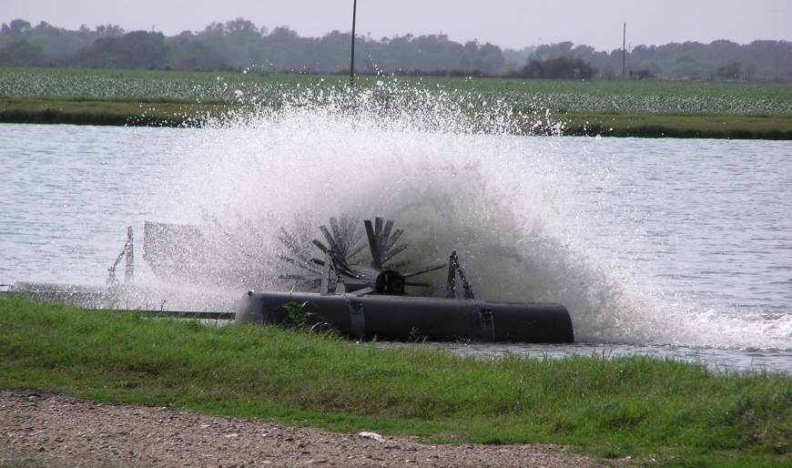
Heavy stocking may require aeration equipment.
Photo by M. Jasek.

Slide 36
How to stock a pond from scratch video
Below are some stocking guidelines.
Channel catfish should not exceed 2,500 per acre.
Shiner or fathead minnow should be stocked 1,000 to 3,000 per surface acre.
Crayfish can be stocked at a rate of 100 breeder-size per acre.

Slide 37
Largemouth and smallmouth bass stocking is recommended at 100 per acre per species.
Triploid grass carp maximum stocking with permit is seven per acre.
New ponds can stock smaller, less expensive fish.
As the population becomes more diverse, the numbers of each species should be adjusted to accommodate each species.

Slide 38
Controlling Fishing Pressure
Fishing is a time to relax and enjoy the outdoors.
Pond management requires fishing to control populations to maintain the food supply in the pond.
A short food supply will stunt fish growth.
The highest fish production takes place with 300 to 500 hours of fishing per acre per year.

Slide 39
Fishing should start in a newly stocked pond when each fish species reaches edible size or sexual maturity.
This normally takes place one year after stocking.

Slide 40
Fishing should also target selected species.
About 10 to 12 sunfish should be caught for each bass or catfish that is taken.
If sunfish are caught that are too small for human consumption, they should not be returned to the pond.

Slide 41
Feeding Fish
Feeding fish in a recreational pond is different than in a production or aquaculture pond.
Recreational pond feeding may involve stocking fodder species, fertilizing, or a feeding program using commercially prepared feeds.

Slide 42
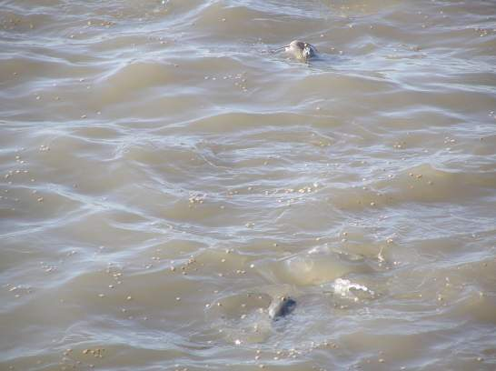
Since fodder has already been discussed, the focus here will be on commercial feeds where rapid gains or growth are the goals.
Photo by M. Jasek.

Slide 43
All nutritional needs of fish are similar to other animals.
They need protein, carbohydrates, fats, minerals, vitamins, and water.
Each fish species has specific needs.
The protein content for tank culture ranges from 28 percent to 30 percent.

Slide 44
Commercial feeds are available as either floating or sinking pellets.
Surface feeding allows the manager to observe fish activity.
Pellets should remain stable for at least 30 minutes and the manager should not feed more than the fish will eat in a 15 to 20 minute time period.

Slide 45
Antibiotics can be added to commercial feeds when the Cool Feed Process is used to make feeds.

Slide 46
Pond Management
Both new and existing ponds need to be prepared for successful stocking.

Slide 47
New ponds need fertilization prior to filling with water.
Pre-stocking a new pond with fodder species should be done before game fish stocking.

Slide 48
Established ponds may need to have excessive vegetation removed.
Removal of trash fish species may be necessary.
Consulting an experienced, reputable pond manager prior to stocking may be worth the investment.

Slide 49
Some businesses provide free consultation.
Their recommendations may be based on their need to sell stocker fish, not what the landowner actually needs.
The county extension service is another good source for pond management information.

Slide 50
Trash fish are those species that have little or no value, include gar, gizzard shad, and bullhead catfish.
They enter ponds as eggs attached to the legs of water birds.

Slide 51
Rotenone is a chemical that can effectively remove trash fish from a waterway.
Gar and bullheads are resistant to rotenone, as are larger fish.

Slide 52
Rotenone levels toxic to fish are not harmful to humans or livestock.
Effects begin within 30 minutes of application and become absent within a week after application.

Slide 53
Muddy or cloudy ponds are a result of acidic water conditions.
Colloidal clay particles are held in suspension because they have the same ion charge as the pond or lake bed.

Slide 54
Reversing the charge will settle the particles.
This can be done by adding seven to ten rectangular bales of hay per acre to the water.
Applying 75 pounds of cottonseed meal or soybean meal and 25 pounds of super-phosphate per acre is another treatment.

Slide 55
Applying gypsum at a rate of 200 pounds per acre may help, if water is slightly turbid.
It may be necessary to increase the application rate to 800 pounds per acre, if water is muddy.
Pond fertility can result from natural sources, chemical application, or a combination.

Slide 56
A nutrient-rich pond will increase the growth of phytoplankton, which feeds zooplankton, which in turn feeds small fish that provide fodder to the larger fish.
Illustrations by Christine Stetter.

Slide 57
Nitrogen and phosphorus are two important nutrients for ponds.
They can be applied as commercial fertilizers.
Cottonseed meal is an organic material that can stimulate plankton growth.

Slide 58
Fertilization should take place two weeks before stocking and when the water temperature is about 60°F.
A second application two weeks after stocking may be beneficial.
A third application may be applied, if needed.

Slide 59
There are hazards that can accompany high pond fertility.
These hazards involve phytoplankton, which are plants.
A nutrient-rich, clear pond will allow phytoplankton to grow in the presence of sunlight.

Slide 60
When plants photosynthesize, they give off oxygen.
Without sunlight, plants respire and give off carbon dioxide.

Slide 61
Additionally, fish give off ammonia wastes through their gills.
This is an additional food source for the microscopic plants.
Too high nutrient levels promote excessive phytoplankton growth or bloom.

Slide 62
When the phytoplankton outgrow their food supply, they die or crash.
Aerobic bacteria begin decaying dead microscopic plants.
They use oxygen and produce carbon dioxide.
Without enough dissolved oxygen in the water and too much carbon dioxide, the fish will die.

Slide 63
Phytoplankton serve two purposes:
a food source of zooplankton and fry, and
restrict the amount of sunlight that can enter the water, thereby controlling the growth of undesirable vegetation.

Slide 64
The density of phytoplankton affects turbidity (the coloration of water).
Turbidity is checked using a Secchi disk.
Turbidity testing is not used in muddy waters.

Slide 65
Hundreds of aquatic plant species grow in water.
Some are beneficial and do not require control.
Others can attract snakes or interfere with fishing and need to be removed.

Slide 66
Plants also compete with the fish for oxygen at night or during cloudy days.
New pond design can help in preventing aquatic plant problems.
Aquatic herbicides are useful and some are selective in the plants they control.

Slide 67
ALL RIGHTS RESERVED
Reproduction or redistribution of all, or part, of this presentation without written permission is prohibited.
Instructional Materials Service
Texas A&M University
2588 TAMUS
College Station, Texas 77843-2588
http://www-ims.tamu.edu 2006

