Slide 1
Forms/Color Project

Slide 2
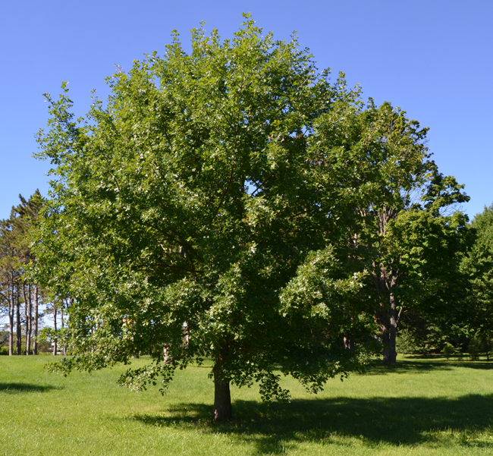
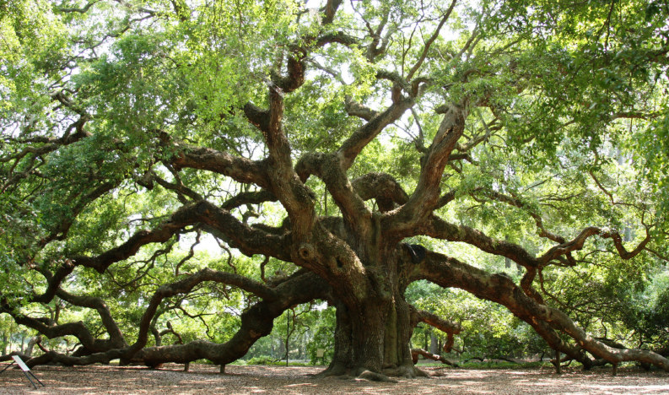
Round Form (Trees)
Common Name: Shumard Red Oak Common Name: Live oak
Scientific Name: Quercus shumardii Scientific Name: Quercus virginiana
Water: low amounts Water: moderate
Sun: high amounts. Sun: Large amounts

Slide 3
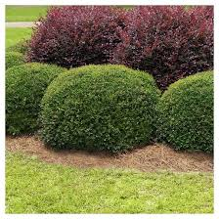
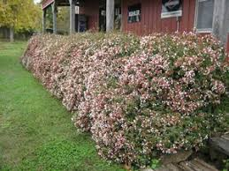
Round Form (shrubs)
Common Name: Dwarf Yaupon Holly Common Name:Abelia
Scientific Name:Ilex vomitoria Scientific name:Abelia x grandiflora
Sun: High amounts Sun:Moderate
Water:Low amounts Water:average

Slide 4
Conical form (Trees)
Common Name: Southern red cedar Common Name:Bald Cypress
Scientific Name:Cedrus Scientific Name:Taxodium distichum
Sun: High amounts Sun: High amounts
Water: low amounts Water: medium

Slide 5
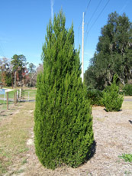
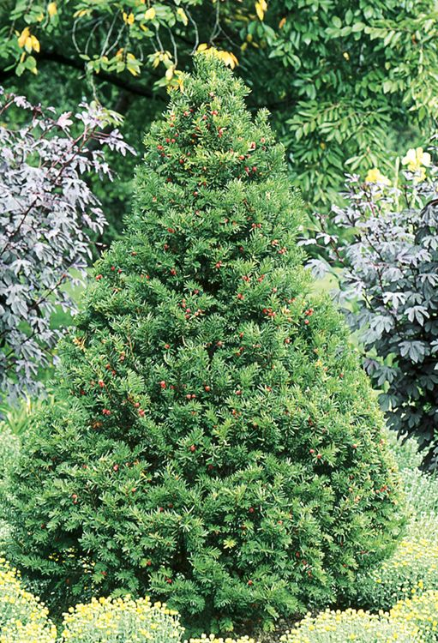
Conical Form (shrubs)
Common Name:Japanese yew Common Name:Spartan juniper
Scientific Name:Taxus cuspidata Scientific Name:Juniperus chinensis
Sun: high amounts Sun:high amounts
Water:moderate water Water:Low amounts

Slide 6
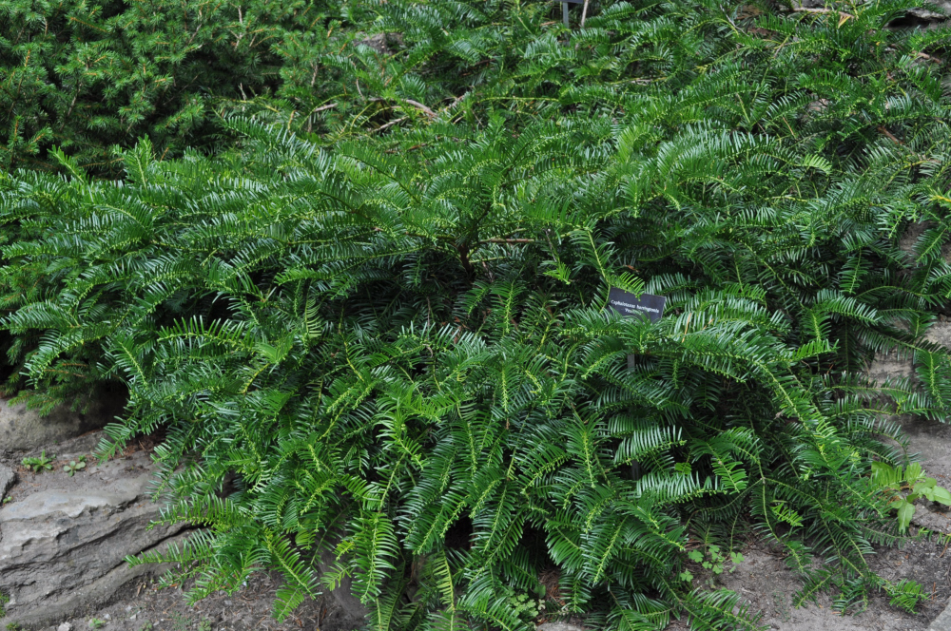
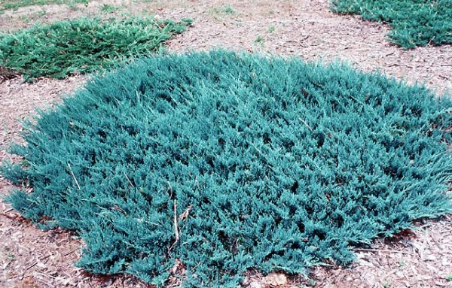
Horizontal (shrubs)
Common Name:Ice blue juniper Common Name: Plum Yew
Scientific name:Juniperus Scientific name:Cephalotaxus Harringtonia
Sun:Full sun or light shade Sun:low amounts
Water:moderate Water:moderate

Slide 7
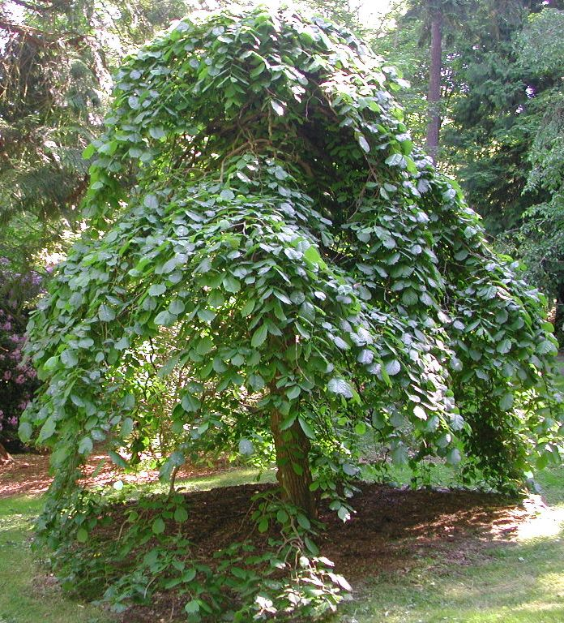
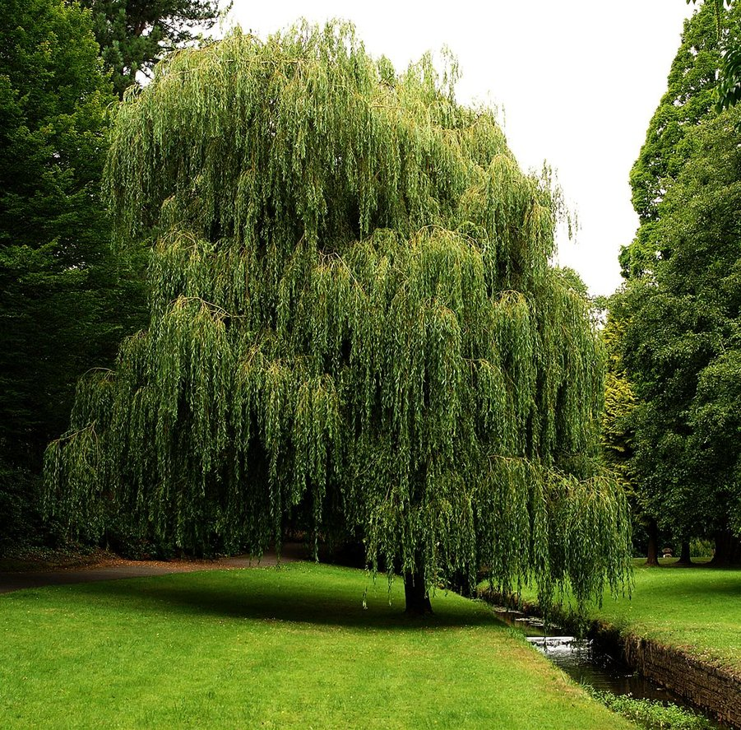
Weeping Form(trees)
Common Name: Weeping Willow Common Name:Camperdown elm
Scientific Name: Salix babylonica Scientific Name:Ulmus glabra '
Sun: Medium amounts Sun:High amounts
Water: moderate Water:moderate

Slide 8
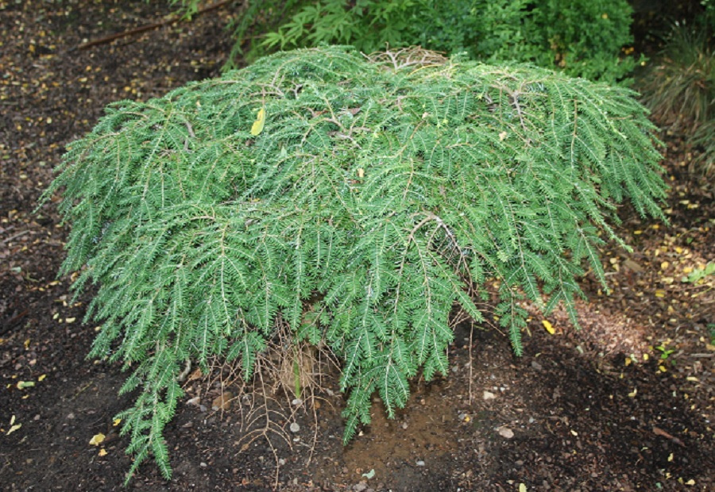
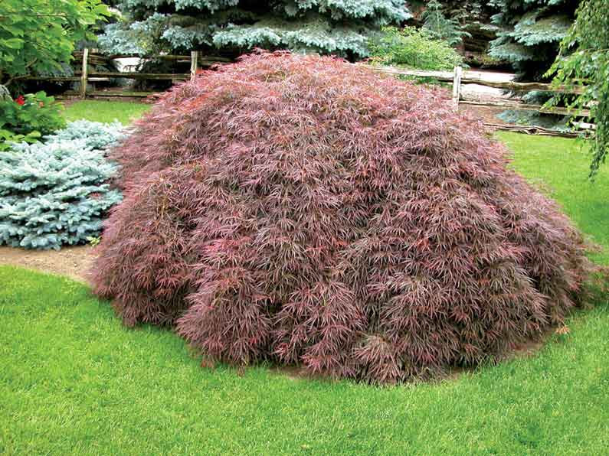
Weeping Form(shrubs)
Common Name:weeping Japanese maple Common Name: Coles prostrate
Scientific Name: Acer Palmatum Scientific Name:Cole's Prostrate
Sun:Medium amount of son Sun: high amounts
Water:regularly Water:Regularly

Slide 9
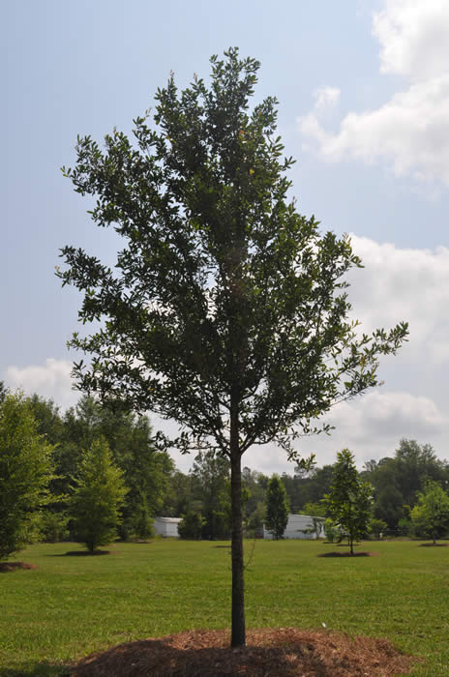
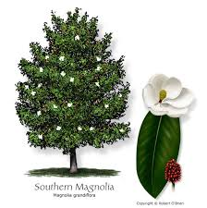
Oval form (trees)
Common Name: southern live oak Common Name: Magnolia
Scientific Name:Quercus virginiana Scientific name:Magnolia grandiflora
Sun:medium amount Sun:high amount
Water: low amounts Water:regular watering

Slide 10
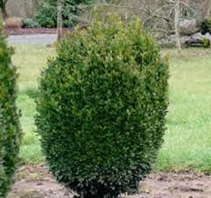
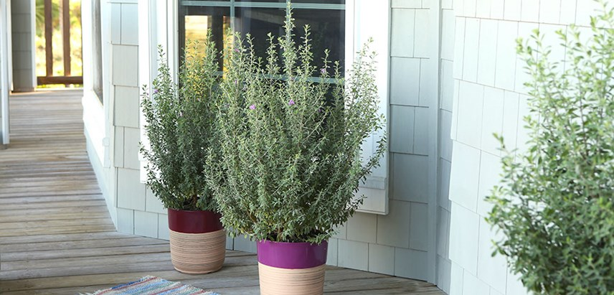
Oval(shrubs)
Common Name:Texas Sage Common Name:Boxwood
Scientific Name:Leucophyllum frutescens Scientific Name:Buxus
Sun: high amount Sun:high amount
Water:low amount Water: average water

Slide 11
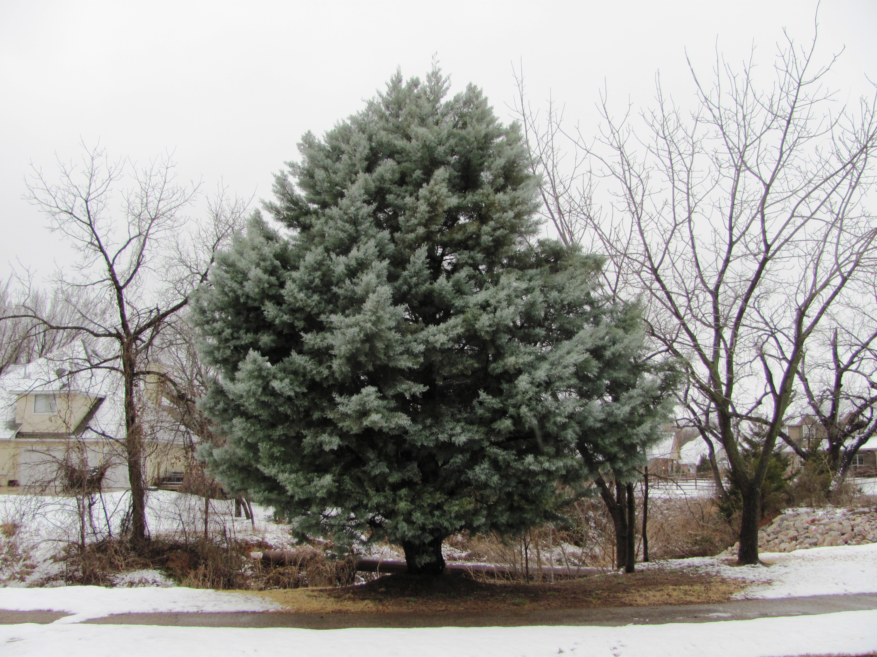
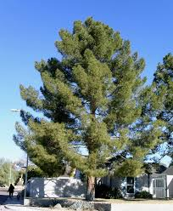
Upright (tree)
Common Name: Afghan pine Common Name: Arizona cypress
Scientific Name:Pinus brutia Scientific name:Cupressus Arizonica
Sun:high amount Sun: High amount
Water: low Water:low

Slide 12
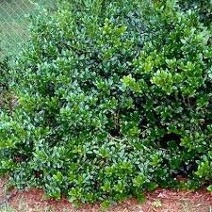
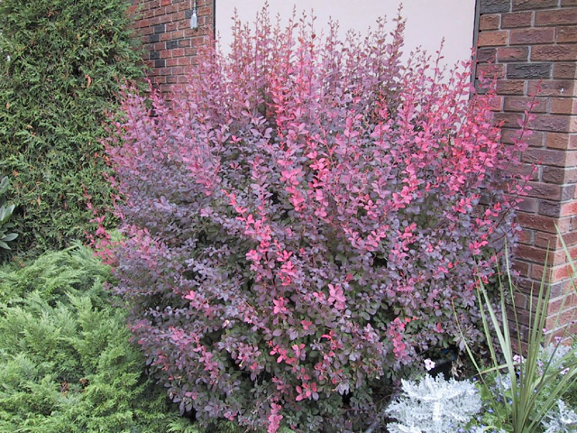
Upright (shrub)
Common name:Dwarf Burford Holly Common name: red barberry
Scientific name:Ilex cornuta Scientific nambe:Berberis Thunbergii
Sun:Large amounts Sun:Large amounts
Water:medium Water: regularly

Slide 13
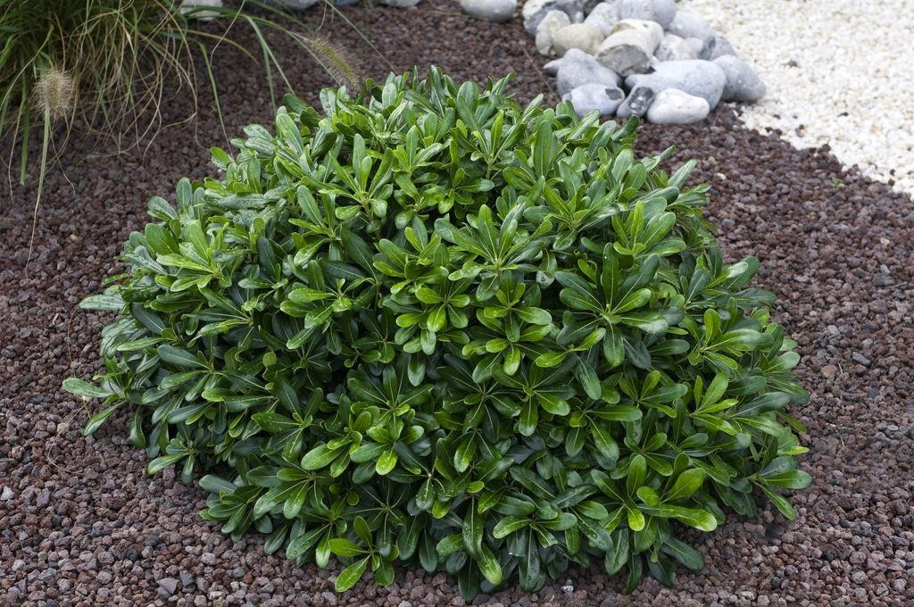
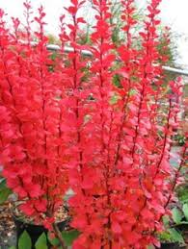
complimentary
Common Name: Pittosporum Common Name: red barberry
Scientific Name: Pittosporum tobira Scientific name:Berberis Thunbergii
Sun:partial sun Sun: Full sun or part shade
Water: regularly Water:regularly

Slide 14
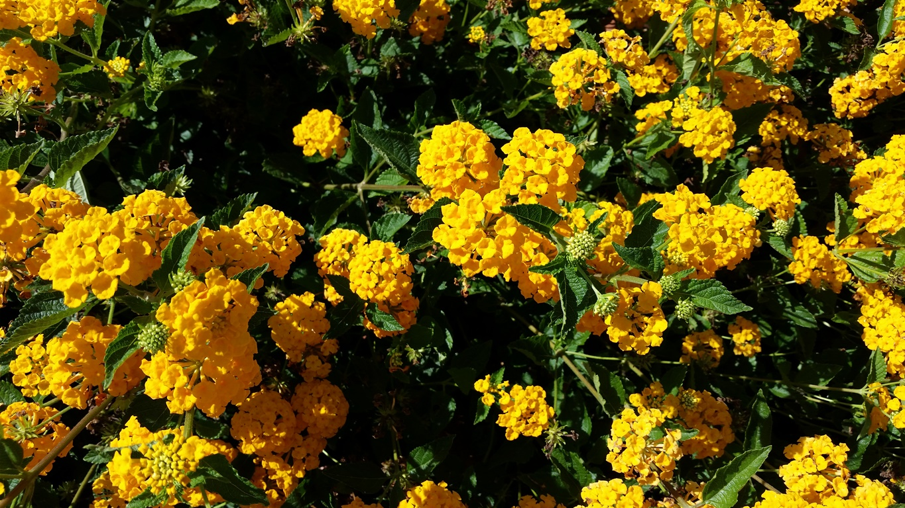
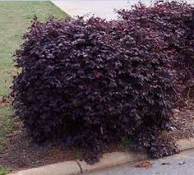
complimentary
Common name: yellow lantana Common name:purple loropetalum
Scientific name: Lantana Camara Scientific name:Hamamelidaceae
Sun: High amounts Sun: medium amounts
Water: low Water: medium

Slide 15
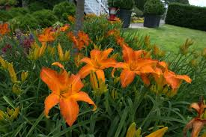
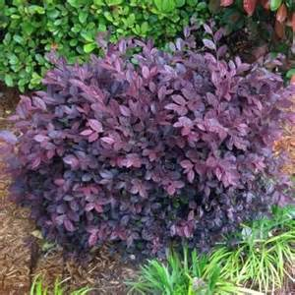
Triadic
Common Name: Daylily Common Name:purple loropetalum
Scientific name: Hemerocallis lilioasphodelus Scientific Name:Hamamelidaceae
Sun: High amounts Sun:high amounts
Water:medium Water:medium

Slide 16
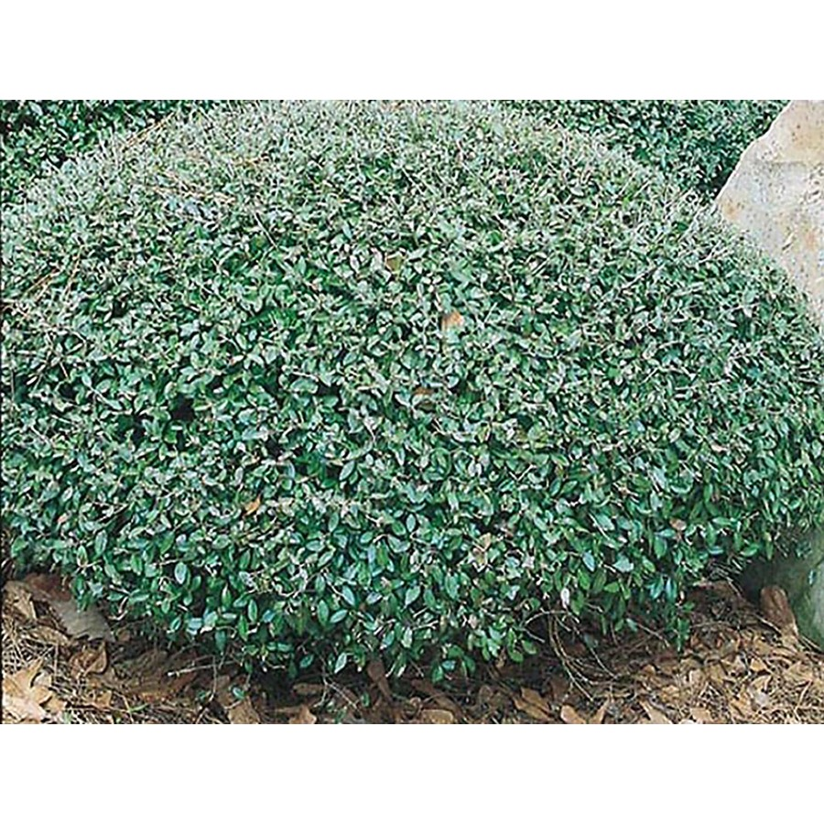
Triadic continued
Common name: dwarf yaupon holly
Scientific name:Loropetalum chinense
Sun:High amounts of sunlight
Water:medium

Slide 17
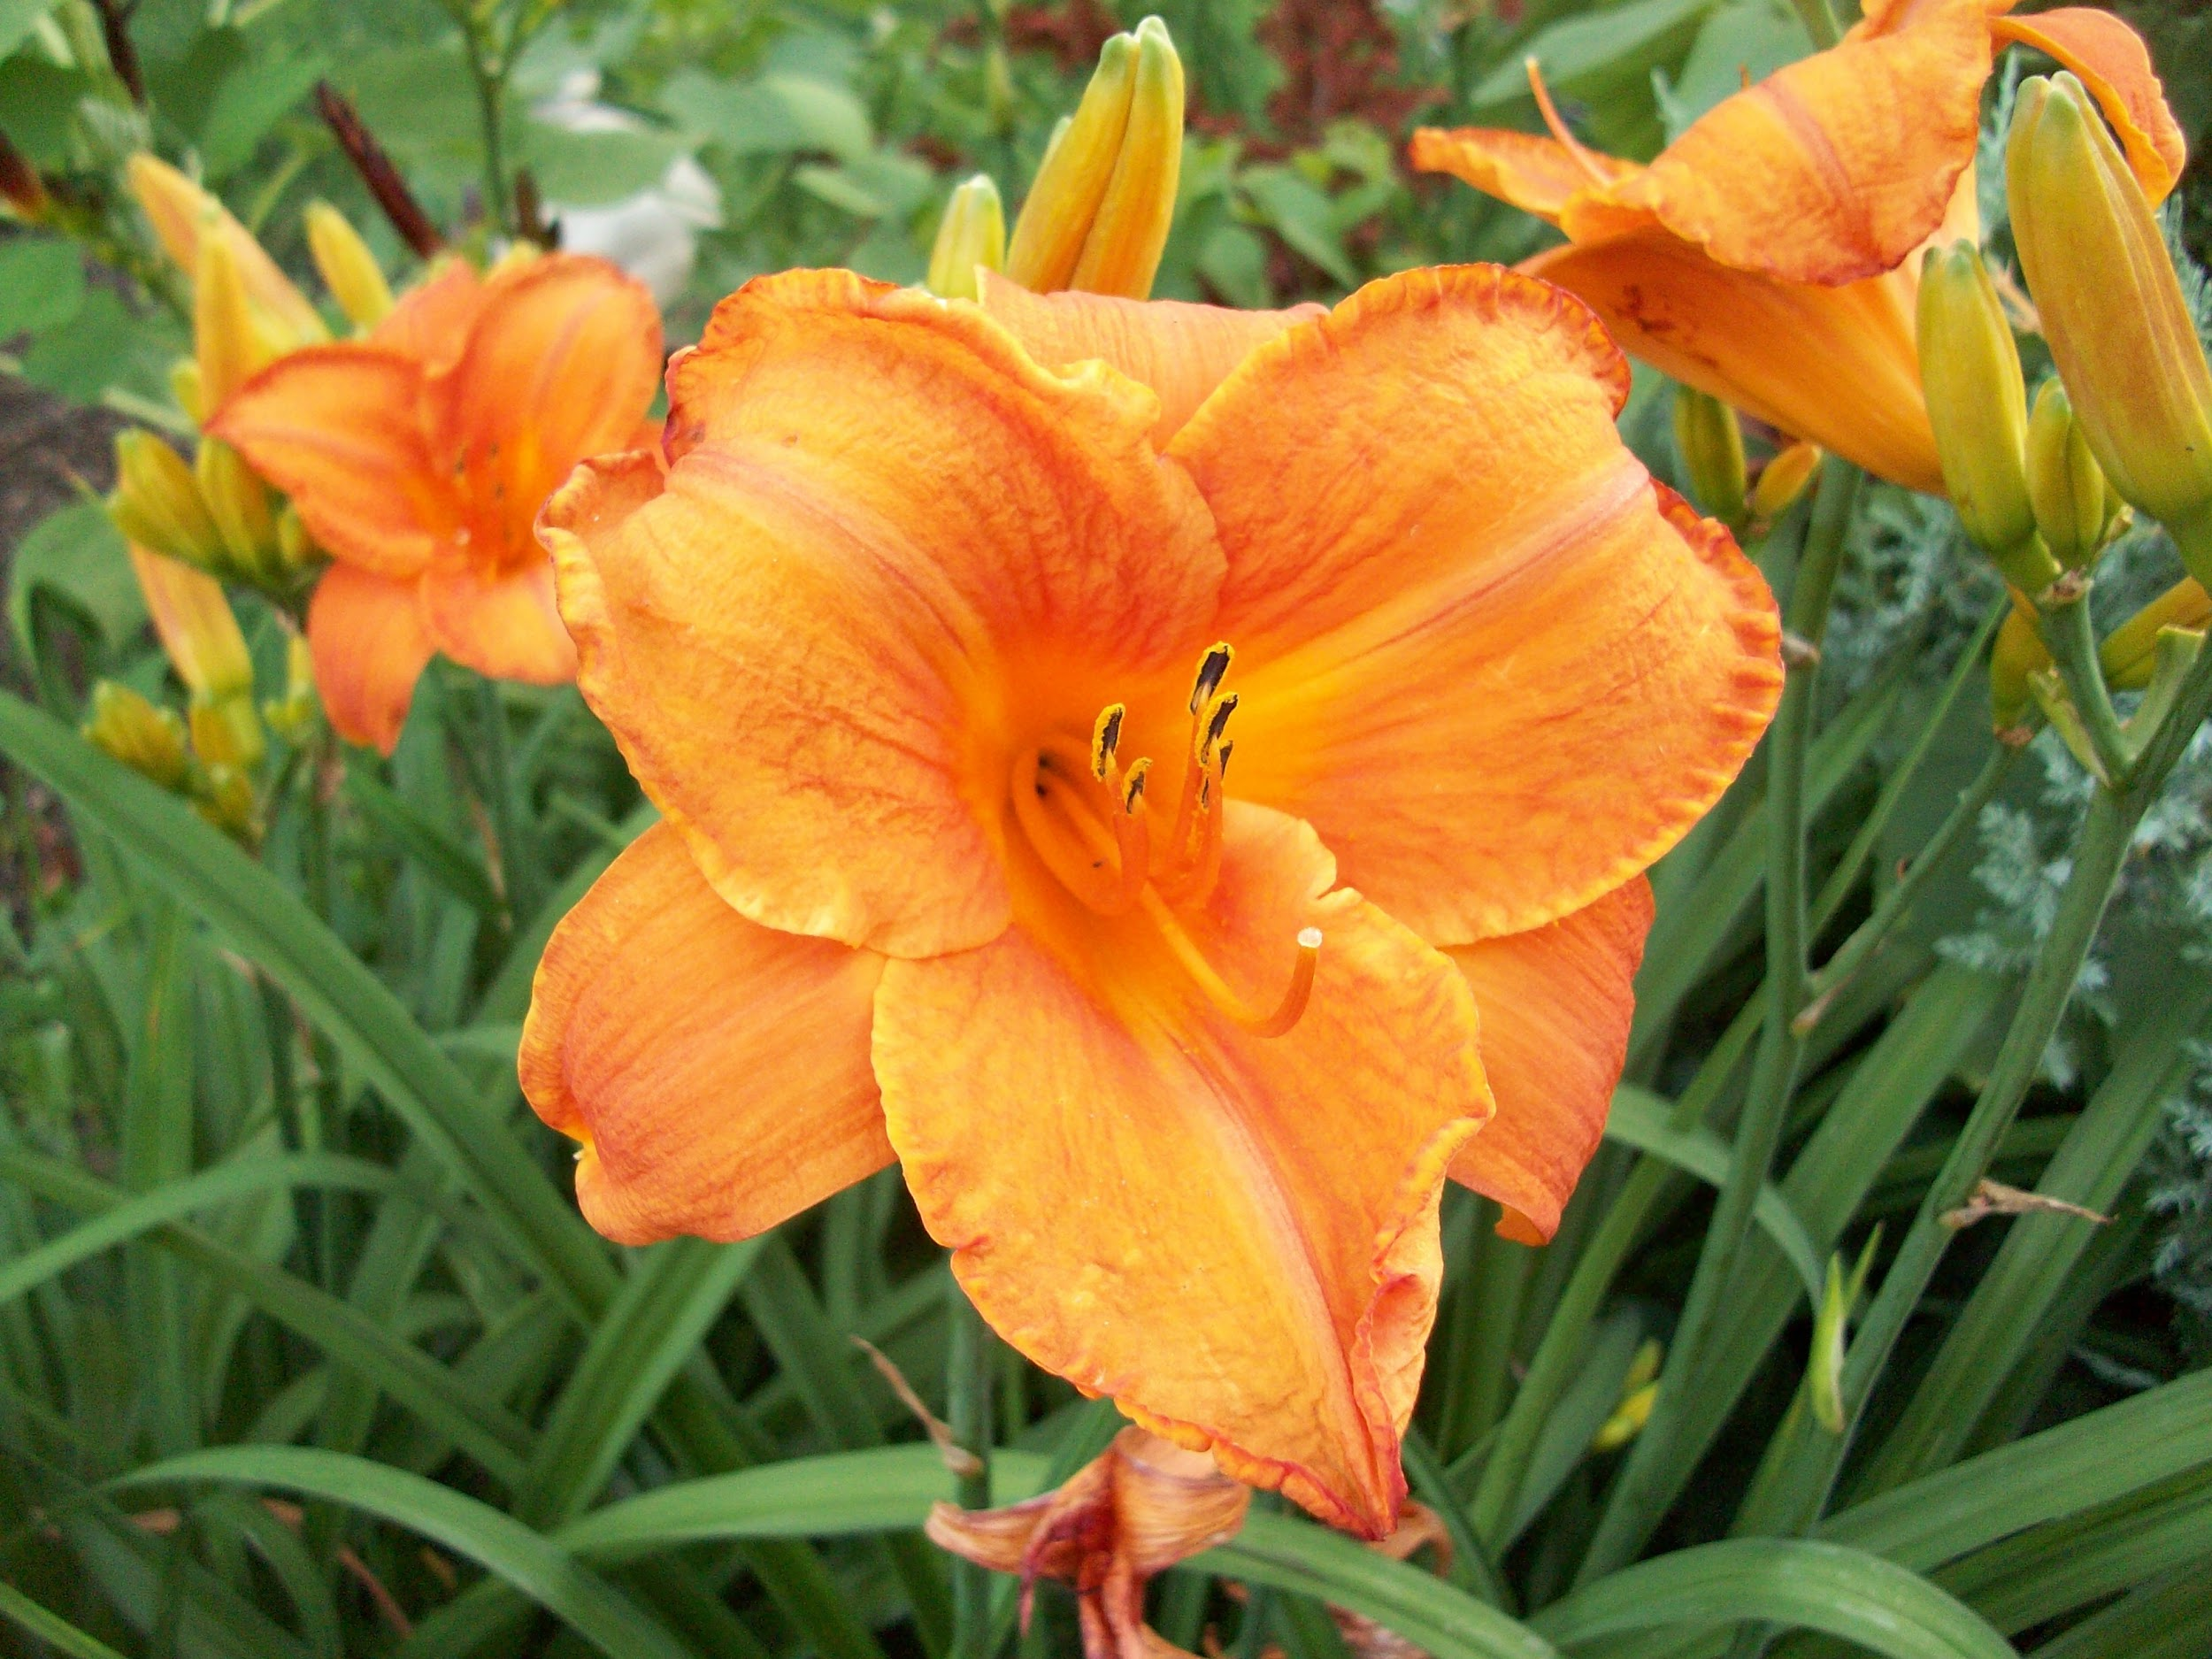
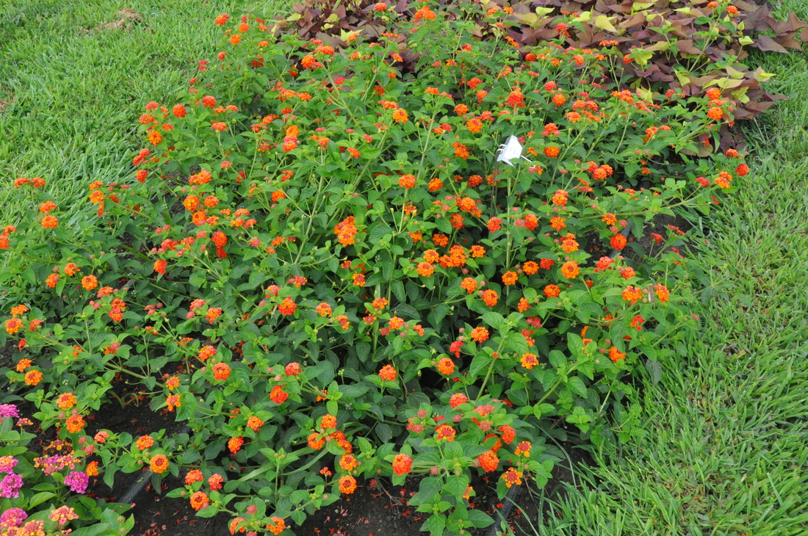
Analogous
Common name: orange lantana Common Name: Daylilies
Scientific name:Lantana camara Scientific name: Hemerocallis lilioasphodelus
Sun: High Amount Sun: high amount
Water: low Water: medium

Slide 18
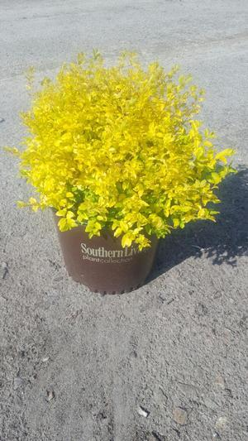
Analogous continued
Common name: sunshine ligustrum
Scientific name:Ligustrum sinense
Sun: high amount
Water: Low

Slide 19
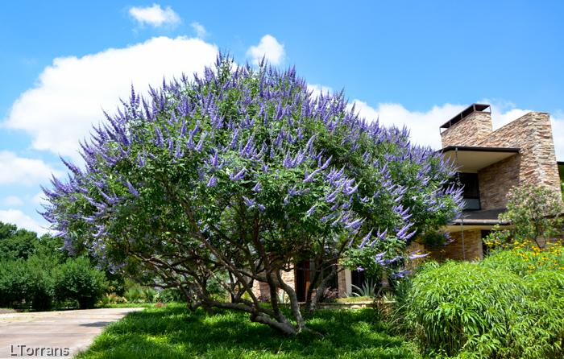
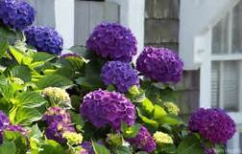
Monochromatic
Common name: hydrangea Common Name:vitex
Scientific Name:Hydrangea Macrophylla Scientific Name:Vitex agnus-castus L.
Sun:low amount Sun: full sun
Water: high amount Water:low

Slide 20
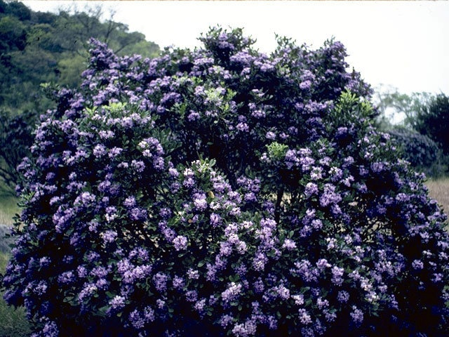
Monochromatic
Common name: texas mountain laurel
Scientific Name:Kalmia latifolia L.
Sun:large amounts
Water:low

